Slide 1
A Testbed for Resilient Cyber-Physical Systems
ROSMOD
William Emfinger and Pranav Srinivas Kumar
This work was supported by the AFRL SCIENCE OF SECURE AND RESILIENT CYBER-PHYSICAL SYSTEMS project under contract FA8750-14-2-0180. We thank them for their generous support. Any opinions, findings, and conclusions or recommendations expressed in this material are those of the author(s) and do not reflect the views of DARPA or AFRL.

Slide 2
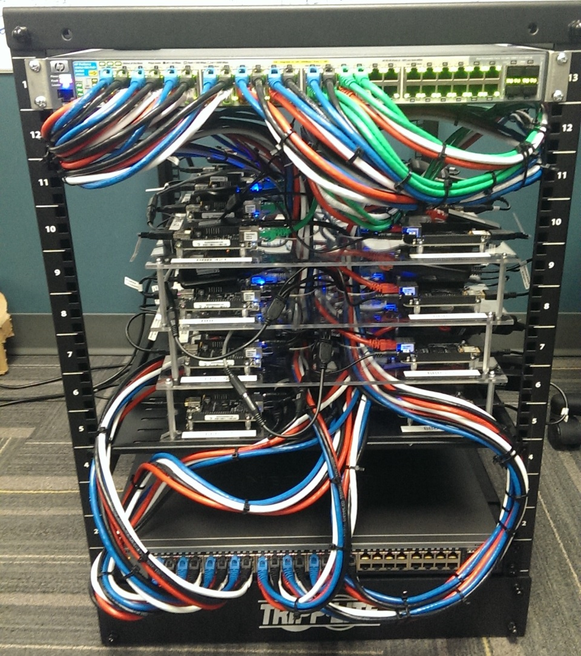
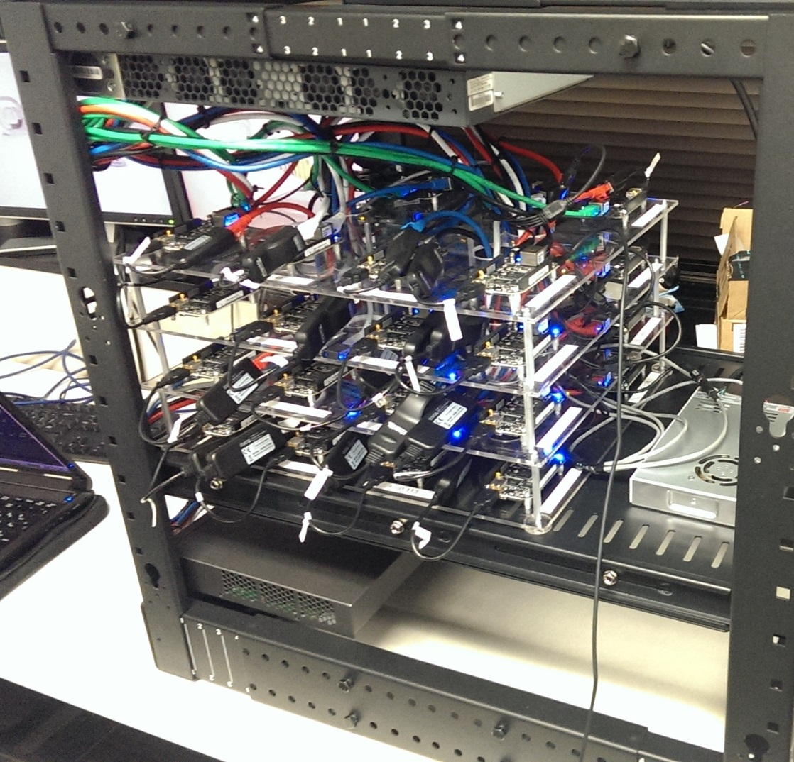
RCPS Testbed

Slide 3
Overview of the RCPS Testbed
Embedded system hardware hosts running actual code (i.e. code that would run in the real CPS)
Physical system simulator that simulates the physics of the physical system, all sensors, all actuators, and the environment
Code running on the hosts communicates with the physics simulator to get current sensor state and to control the actuators
Smart network switch (using OpenFlow) allows emulation of network resources to accurately emulate the system’s network possible effected by the physics (simulator)
Integrated analysis and measurement tools to allow us to run tests on the system and its applications
Modeling tools, code generators, and deployment/monitoring utilities mean we can spend more time focusing on our tests and less time focusing on infrastructural issues

Slide 4
Use Cases for the RCPS Testbed
Security:
Algorithms: we can deploy applications that test various distributed algorithms, e.g. consensus algorithms designed to address the Byzantine Generals problem, and measure the speed of convergence or interactions with system faults and resilience countermeasures
Infrastructural: given the hardware of the system and the software running on it, we can test different attack vectors for, e.g., gaining unauthorized access to the file systems, bringing down hosts, or compromising nodes.
Resilience:
Since we have actual hardware, we can introduce many faults into the system, e.g. sudden host failure, sudden network failure, etc. and measure how the system and its applications respond to the faults
Analysis:
By integrating system and software modeling and the component implementations, we can validate the models through monitoring and develop more precise models of interaction patterns for anomaly detection, e.g. DDoS network traffic profiles versus stable system network traffic profiles.

Slide 5
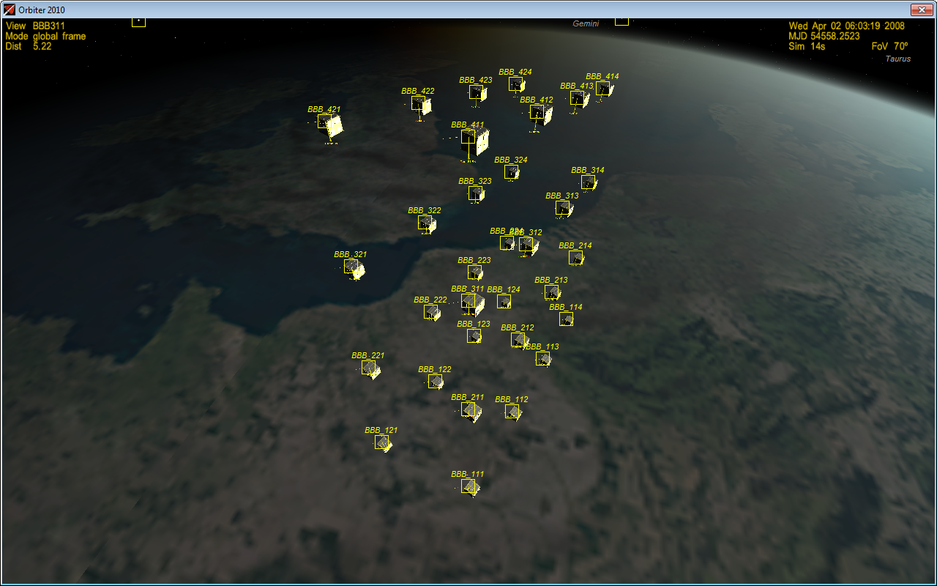
Orbiter Space Flight Simulator

Slide 6
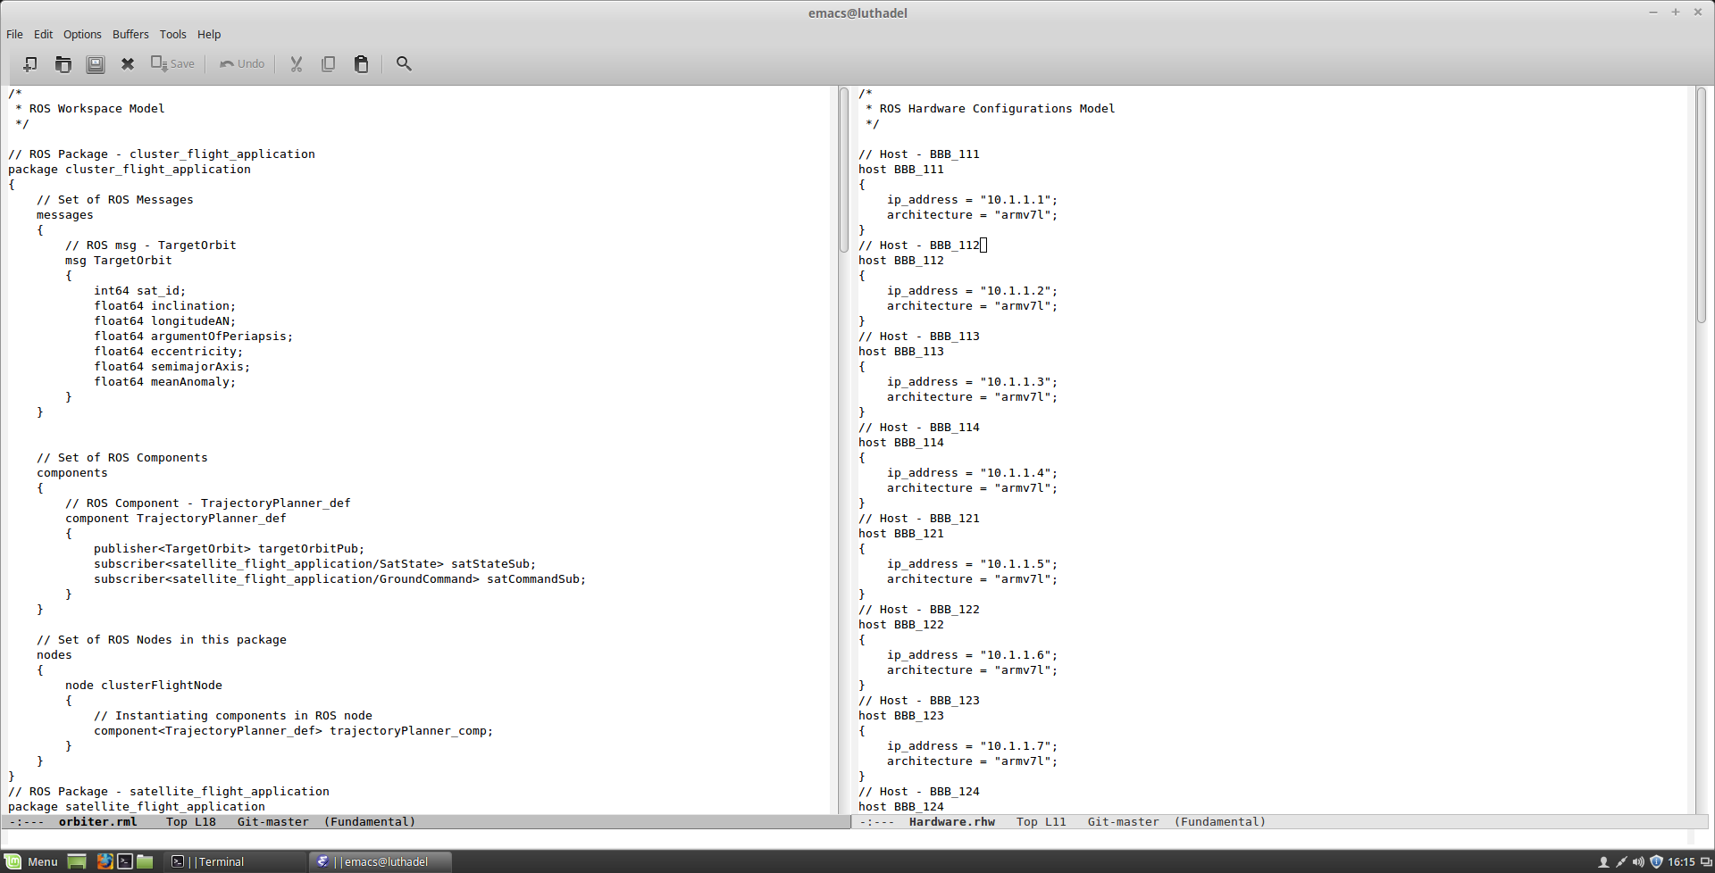
Modeling Software & Hardware
Software Model
Hardware Model

Slide 7
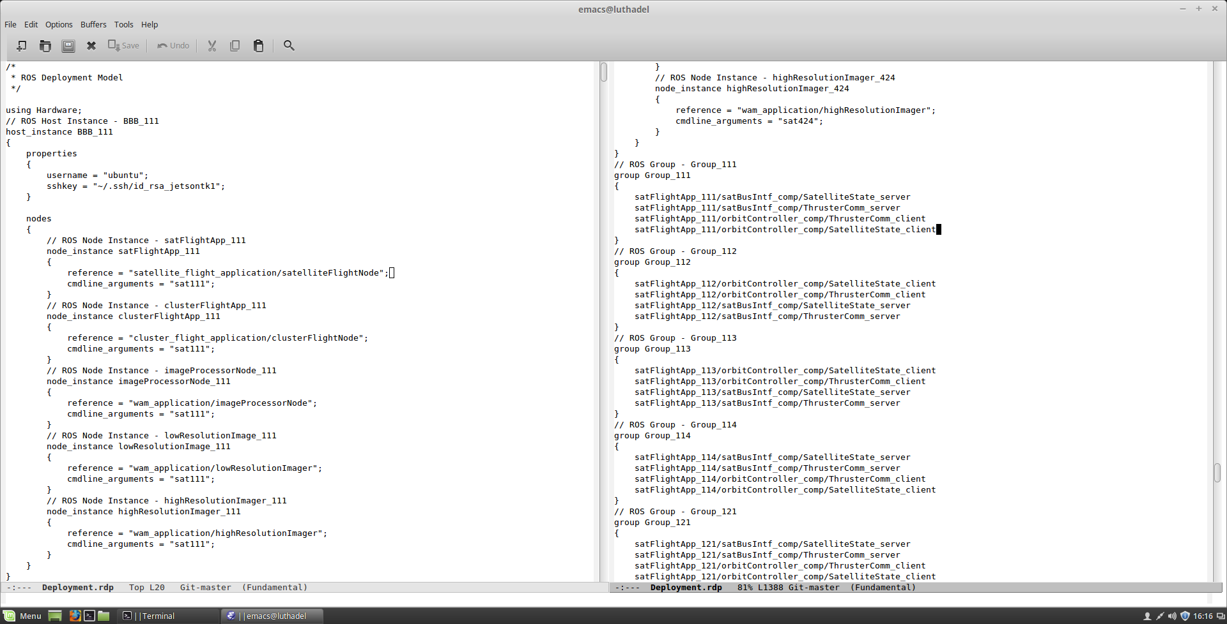
Modeling CPS Deployment
Deployment Model
Modeling Port Connections

Slide 8
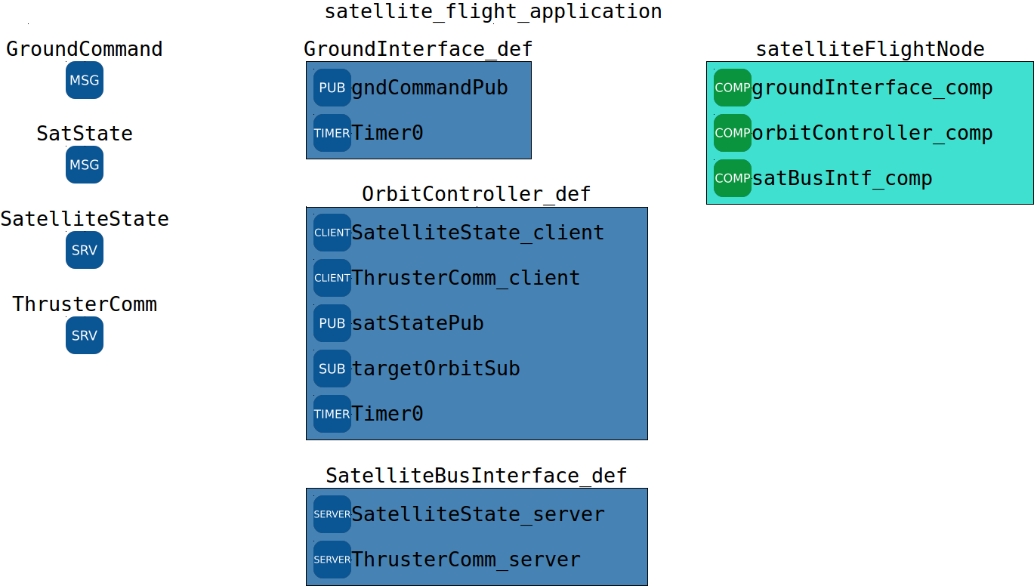
Orbiter Sample - Software Configuration

Slide 9
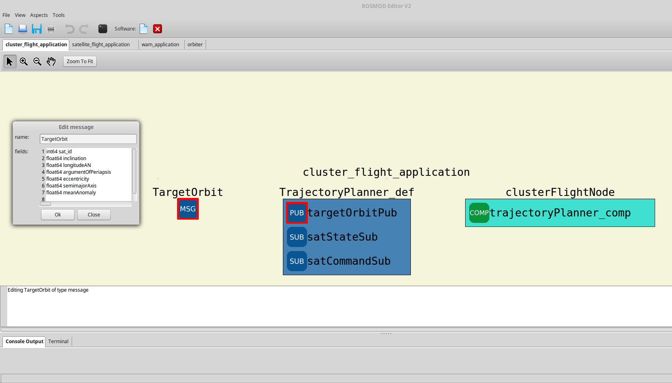
ROS Messages

Slide 10
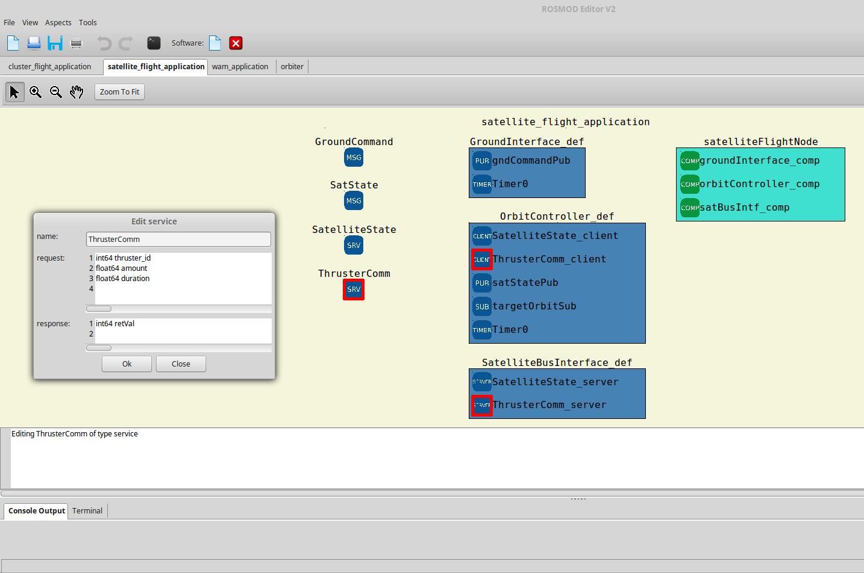
ROS Services

Slide 11
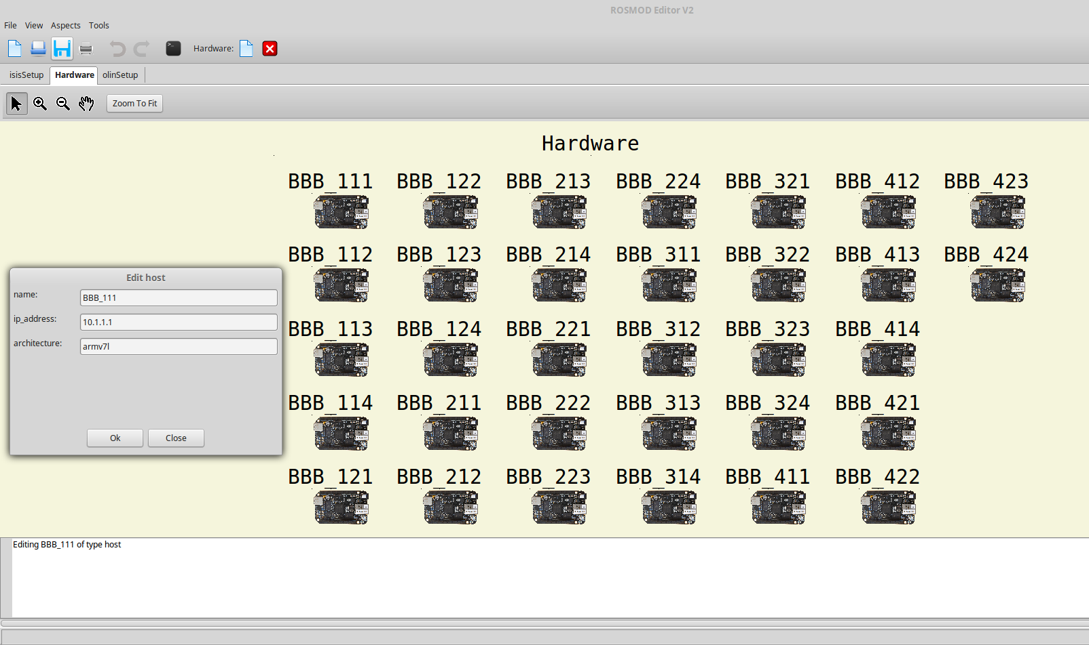
Hardware Configuration

Slide 12
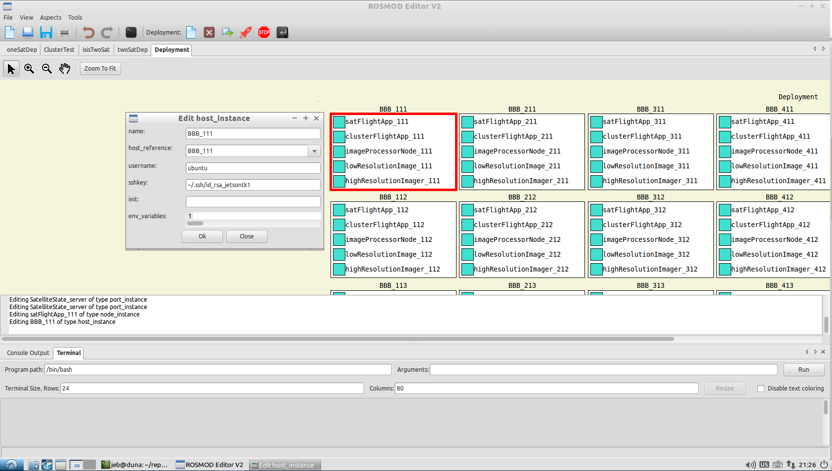
Deployment: Host Instances

Slide 13
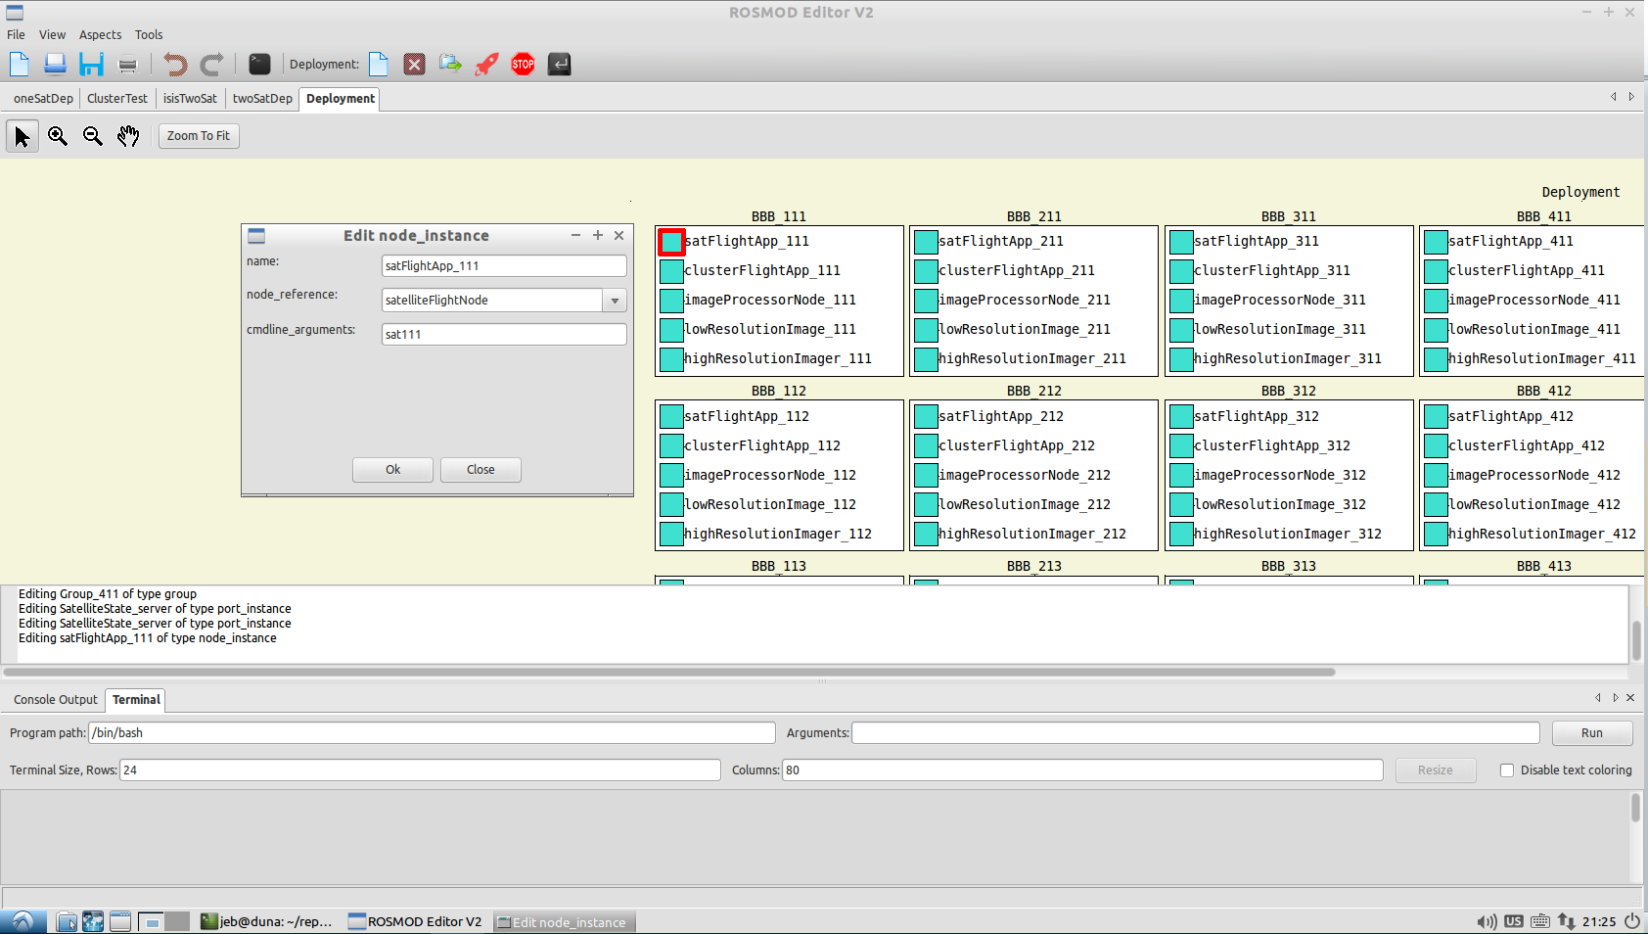
Deployment: Node Instances

Slide 14
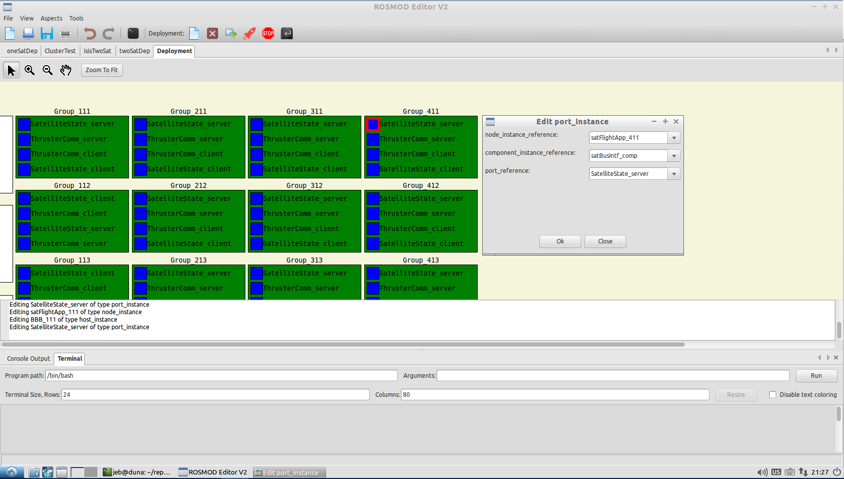
Deployment: Port Instances

Slide 15
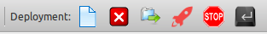
Deployment: Utilities
Create New Deployment
Delete Current Deployment
Copy Deployment Files to all Hosts
Executables
Configuration files (XML)
Deploy Currently Selected Deployment
Stop Currently Running Deployment
Run Command on All Hosts
E.g. reboot, ping, etc.

Slide 16
Orbiter Demo
We have the 32 Host RCPS Testbed running instances of the orbiter demo applications; these applications are
Cluster flight control : handles the cluster trajectory and management
Satellite flight control : handles the retrieval of the satellite’s state from the sensors, the actuation of the satellite’s thrusters, and the communication of the satellite’s state to the rest of the satellites in the cluster
Wide Area Monitoring : imaging application that has different camera sensors distributed throughout the cluster to produce images that are handled by image processors on some hosts of the cluster.
When the cluster receives a control command from the ground station, it must act upon it; e.g. the cluster must scatter in an emergency when it receives the scatter command
We run these applications on the cluster, and can show the integration with the physics simulator:
we send the scatter command to one of the nodes in the cluster
it disseminates the command to the rest of the cluster
the satellites all scatter; shown in the physics simulator for verification

Slide 17
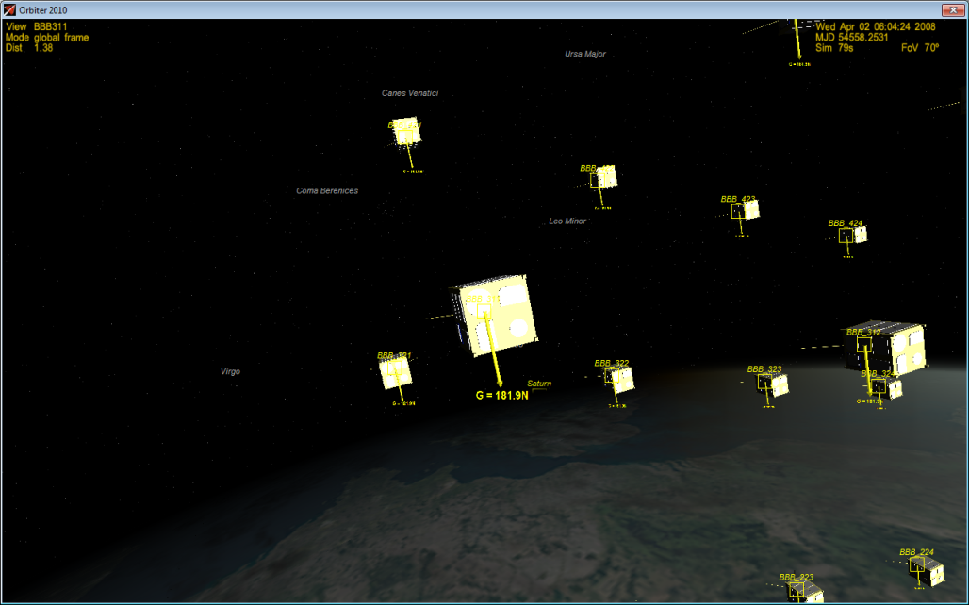
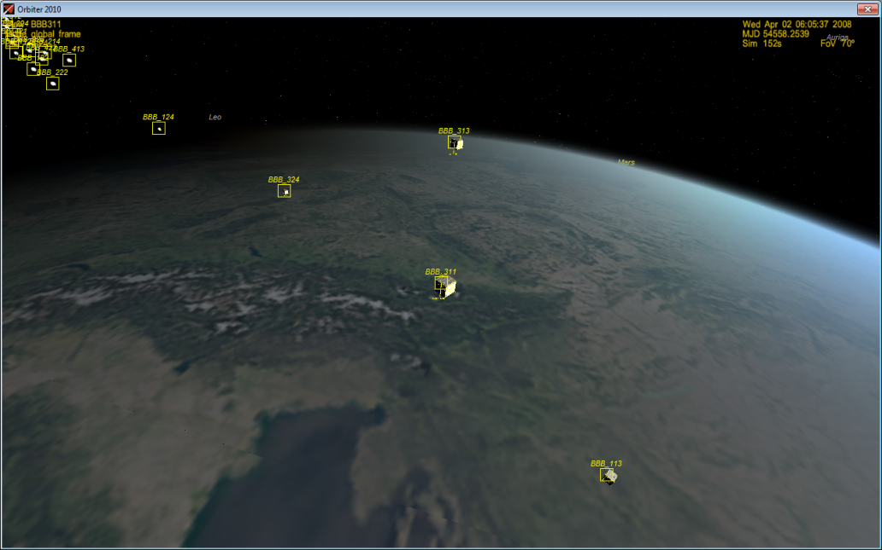
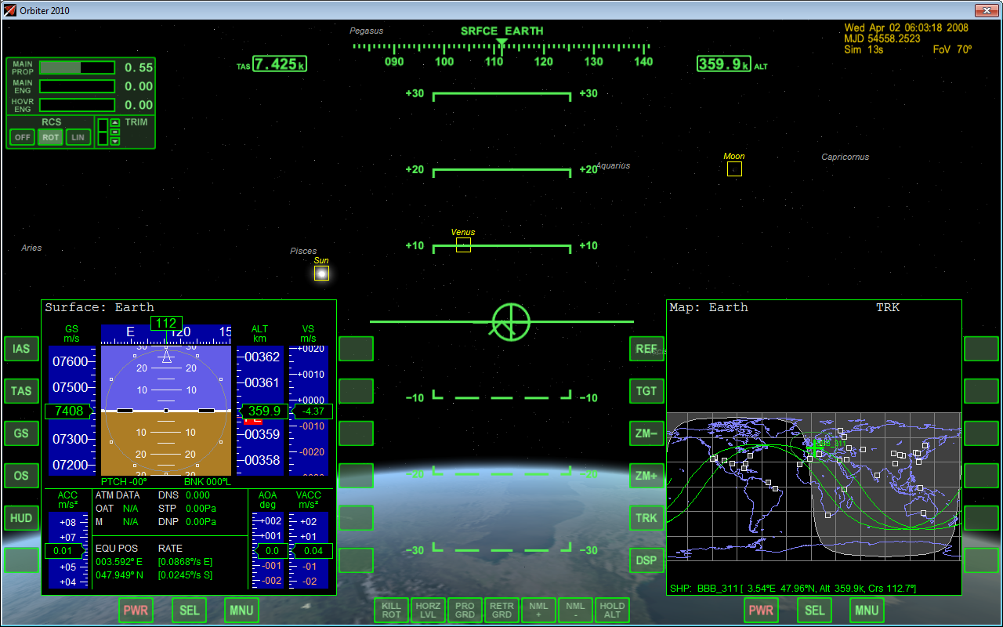
Scattering Satellites

